Slide 1


Impact of Seasonal Changes on Gym Usage
Kritthika Shanmugan, Keerthi Gajjela, Sathiyashivani Sathish Kumar Team: 03, DS522 -Data Acquisition and Analystics

Slide 2
Agenda
Introduction
Literature Review
Dataset
Gym Membership Dataset
Cleaned Gym Dataset
Crowd Dataset
Cleaned Crowd Dataset
Data Wrangling
Average Gym Attendance by Season
Total Attendance : weekdays vs weekends
Attedance: Holidays vs Non-Holidays
Pivot Table
Power BI
Conclusion
Reference

Slide 3
Introduction
Seasonal changes and holidays influence gym attendance patterns through factors like temperature, daylight hours, and activities.
Understanding these patterns helps improve gym operations and member satisfaction.
This project evaluates gym usage trends using membership and overcrowding datasets.
Data preprocessing ensures accuracy for meaningful analysis and insights.
Statistical techniques and Power BI visualizations highlight attendance trends for actionable strategies.

Slide 4
Literature Review
Garriga et al. (2022): Seasonal variations in physical activity (PA) levels show higher activity in summer, emphasizing the need for tailored winter PA interventions.
Buchowski et al. (2009): Seasonal effects on PA reveal significant reductions in winter, especially on weekends, highlighting the importance of year-round PA strategies.
Rand et al. (2020): Reviewed behavior change techniques (BCTs) to improve gym attendance, finding mixed results and urging further research on effective strategies.
McKinney (2022): Highlights Python-based data wrangling and analysis techniques for efficient pre-processing and visualization in large datasets.

Slide 5
Dataset
Analyze seasonal and holiday impacts on gym attendance.
Gym Membership and Crowdedness at Campus Gym (Kaggle).
1,000 entries with demographics and usage patterns.
62,184 entries with attendance times and external factors.
Identify trends and factors influencing gym usage.

Slide 6
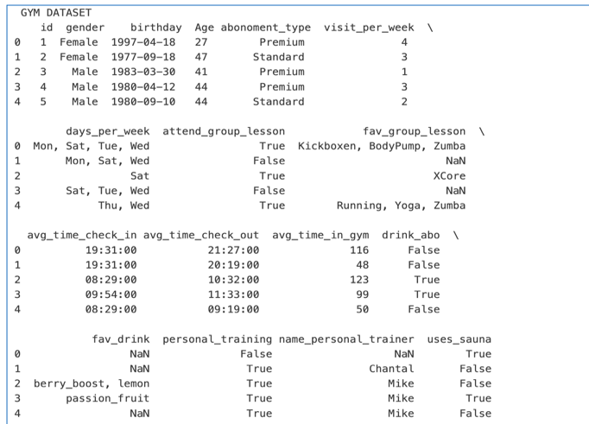
Gym Membership Dataset
Includes age, gender, membership type, and visit patterns.
Key attributes reveal regular visitor trends and peak usage.
Details on check-in/out times and service usage.
Insights optimize membership comparison and attendance management.

Slide 7
Cleaned Gym dataset
Replaced missing categorical values (e.g., gender) with 'Unknown’.
Filled missing numerical values (e.g., age) with the column mean.
Created the visit_per_week column by counting days listed in the days_per_week column.
Imputed missing values in visit_per_week with the average from available records.

Slide 8
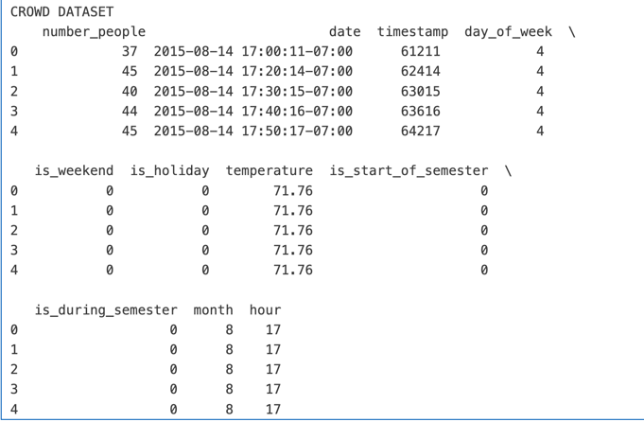
Crowd Dataset
Temporal data reflecting gym attendance influenced by weather, holidays, and academic schedules.
Key fields include number_people, date, and day_of_week for crowd size analysis.
External factors: weekend, holiday and month
Combining with Gym Membership data provides a comprehensive view of attendance patterns.

Slide 9
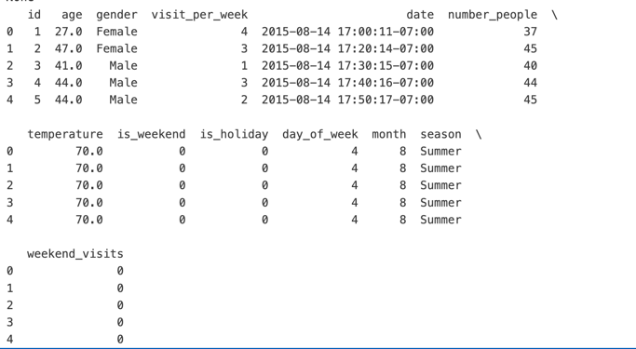
Cleaned Crowd dataset
Merged dataset info
Converted date column to datetime format and clipped temperature to 60°F-70°F. Merged Gym Membership and Crowdedness datasets using a right join to preserve crowd data.
Added an ID column for correct alignment during merging (right join).
Excluded entries with more than 50 people due to gym capacity limits.
The final dataset contains 51,581 records, providing a foundation for analyzing attendance trends.

Slide 10
Data wrangling
Data wrangling transforms raw data into a structured format for analysis.
Includes handling missing values, transforming variables, and merging datasets.
Essential for cleaning inconsistent gym attendance data.
Created season column and calculated weekend attendance using existing data.
Reshaped data to highlight seasonal and weekend patterns.
Clean, structured data is key for generating meaningful insights.

Slide 11
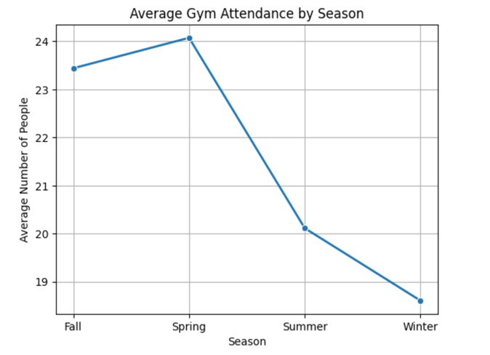
Average Gym Attendance by season
Calculated average gym attendance per season using the "Season" column and aggregation.
Grouped data by season and determined the mean of the number_people values.
Visualized average attendance by season using a line plot with sns.lineplot.
Gym attendance tends to decrease during the winter season and reaches its peak in the spring.

Slide 12
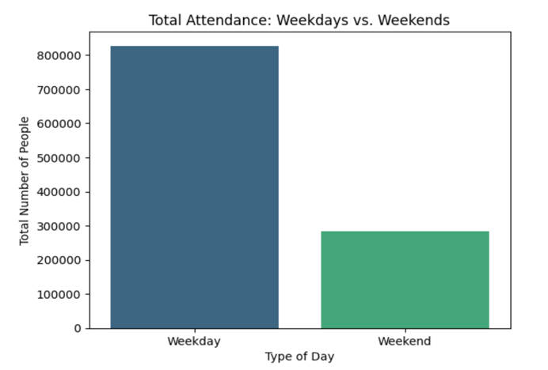
Total Attendance: Weekdays vs. Weekends
Analyzed weekend vs. weekday attendance by filtering the is_weekend column.
Split data into two groups: weekends and weekdays.
Visualized the comparison with a bar plot using sns.barplot.
This bar plot indicates higher attendance on weekdays compared to reduced attendance on weekends.

Slide 13
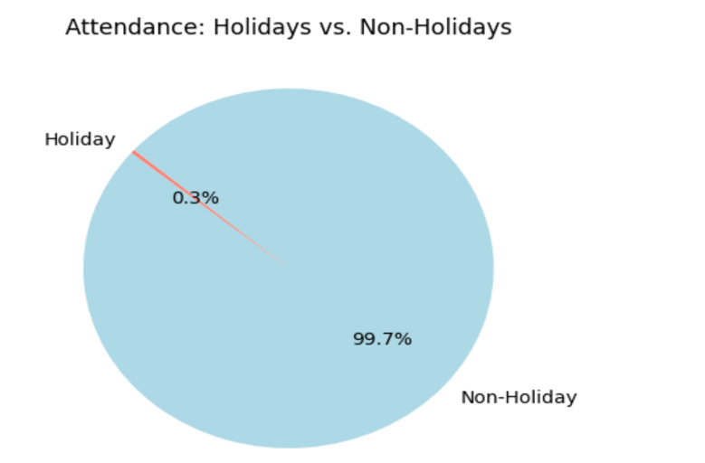
Attendance: Holidays vs. Non-Holidays
Analyzed attendance during holidays by filtering the is_holiday column.
This pie chart shows that holidays slightly impact gym attendance, with 0.3% attending on holidays and 99.7% on non-holidays.
Prepared the dataset for further analysis and visualization in Power BI.

Slide 14
Pivot Table
Used a pivot table to calculate average attendance by season and weekend/weekday.
Grouped data by season and compared weekday vs. weekend attendance.
Created a bar chart to visualize weekday vs. weekend attendance by season.
Used a heatmap to show average attendance by season and weekend/weekday type.

Slide 15
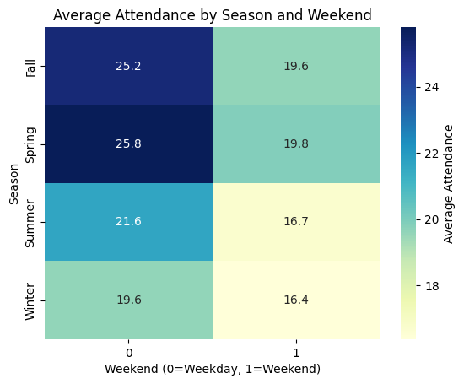
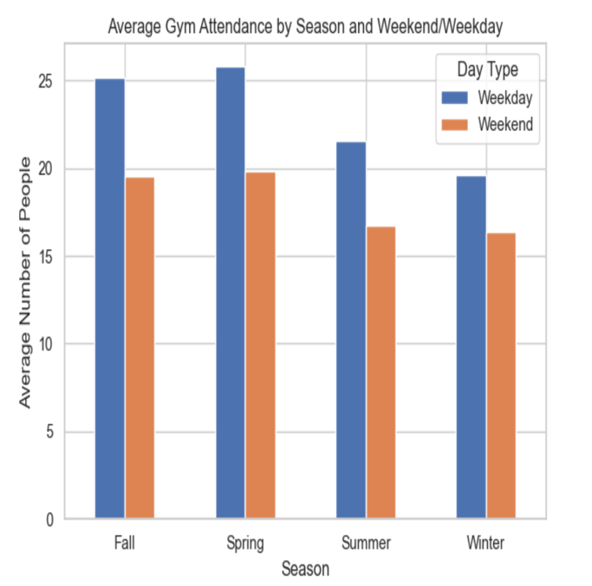
Pivot Table
Bar chart Heat map

Slide 16
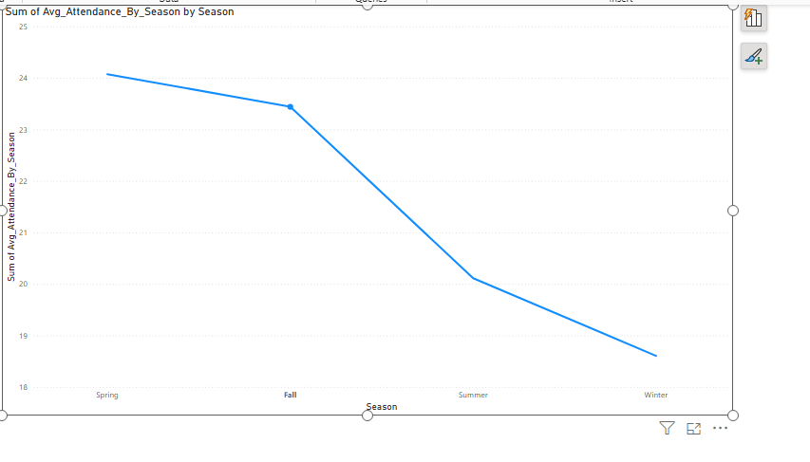
Power BI
Line chart
Power BI created dynamic dashboards to visualize patterns and insights.
Data was merged, cleaned, and transformed in Power BI for consistency.
Line charts showed time-based trends; bar graphs displayed categorical distributions.
Custom DAX queries calculated metrics like average attendance and seasonal trends.
All deliverables, including Power BI files and Python scripts, were hosted on GitHub.

Slide 17
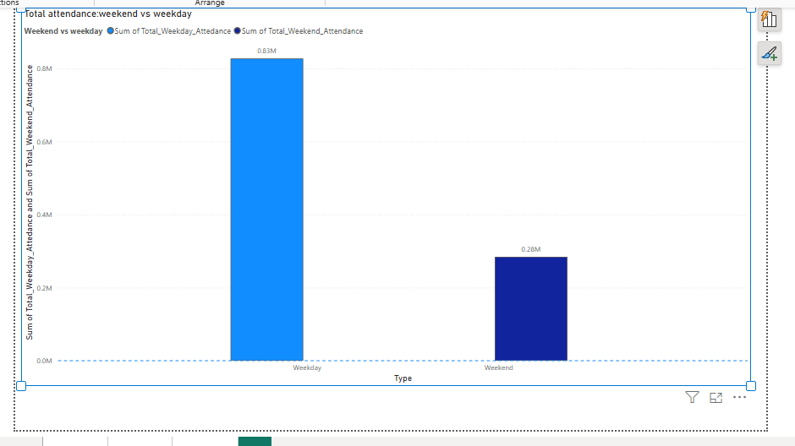
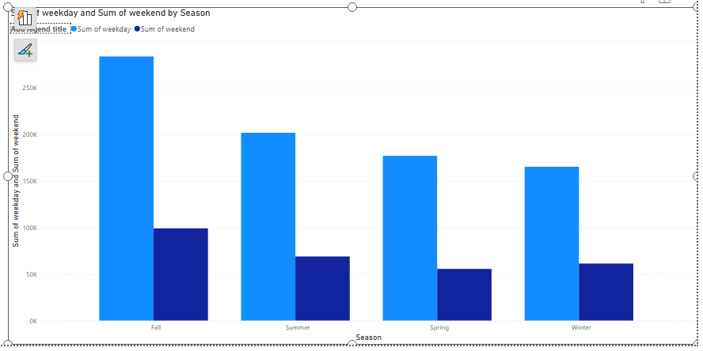
Power BI Visualization
Bar Chart
Pivot Table-Bar chart

Slide 18
Conclusion
Analyzed gym attendance, showing low winter and high Fall activity, with weekends having low attendance.
Visualized data with Python and Power BI to optimize staffing and promotions.
Identified weather and holidays as key factors in gym attendance.
Future research could explore gym capacity and engagement strategies.
Data trends may vary by location and gym type, with limited dataset representativeness.

Slide 19
Reference
Garriga et al. (2021): Impact of seasonality on physical activity patterns and implications for public health strategies.
Buchowski et al. (2009): Study on seasonal changes in physical activity in women, emphasizing the impact of winter on activity levels.
Rand et al. (2020): Systematic review of interventions to increase attendance at fitness venues, identifying effective behavior change techniques.
Kritthika. (2024). Kritthika-DS522_GYM_USAGE_ANALYSIS. GitHub. https://github.com/Kritthika/Kritthika-DS522_GYM_USAGE_ANALYSIS

Slide 20


Q&A

